Slide 1




Medical Billing Virtual Assistant (MBVA)
The future of medical coding
MIDS Capstone Project Presentation (Aug, 2020)
Brent Biseda | Gaurav Desai | Haifeng Lin | Anish Philip
Notes:
Welcome to our presentation. We are the Medical Billing Virtual Assistant team and we are ready to shape the future of medical coding.

Slide 2

Why Do I Need to Pay for Medical Bill Errors?
80% bills with error*
$68,000,000,000
Cost of medical bill errors annually*
Source: 4 in 5 Medical Bills Contain Errors: Here's What You Can Do
Notes:
Let us start with a serious question first. Recall when you received medical bills in the past, did you ever feel that the bill was more expensive than you had expected? Have you ever thought that you might be overcharged by the hospital by mistake? If you had that experience, you probably were right about being overcharged. According to studies by Medliminal Healthcare Solutions and Medical Billing Advocates of America, 8 out of 10 bills contain errors. Every year patients in the U.S. pay $68B for these errors. So why medical bill errors are so common?

Slide 3
A Manual Process to Find Medical Billing Codes
Discharge Summary
History of Present Illness (HPI): Attention difficulties she will talk to him face to face and she is unable to pay attention to him. He was diagnosed with Autism Spectrum Diagnosis (he was diagnosed with PDD). He is going in the 5th grade.
Treatment Options: 10 yo with history of developmental delays, meets criteria for ADHD and ASD. He also has anger issues and anxiety, and may meet criteria for OCD. Strong family history of mood and ADHD. Provided psychoeducation about OCD and anxiety and ADHD
Start Zoloft 25mg. r/b/a including black box warning discussed.
Discharge Summary
History of Present Illness (HPI): Attention difficulties she will talk to him face to face and she is unable to pay attention to him. He was diagnosed with Autism Spectrum Diagnosis (he was diagnosed with PDD). He is going in the 5th grade.
Treatment Options: 10 yo with history of developmental delays, meets criteria for ADHD and ASD. He also has anger issues and anxiety, and may meet criteria for OCD. Strong family history of mood and ADHD. Provided psychoeducation about OCD and anxiety and ADHD
Start Zoloft 25mg. r/b/a including black box warning discussed...
Discharge Summary
History of Present Illness (HPI): Attention difficulties she will talk to him face to face and she is unable to pay attention to him. He was diagnosed with Autism Spectrum Diagnosis (he was diagnosed with PDD). He is going in the 5th grade.
Treatment Options: 10 yo with history of developmental delays, meets criteria for ADHD and ASD. He also has anger issues and anxiety, and may meet criteria for OCD. Strong family history of mood and ADHD. Provided psychoeducation about OCD and anxiety and ADHD
Start Zoloft 25mg. r/b/a including black box warning discussed.
Discharge Summary
History of Present Illness (HPI): Attention difficulties she will talk to him face to face and she is unable to pay attention to him. He was diagnosed with Autism Spectrum Diagnosis (he was diagnosed with PDD). He is going in the 5th grade.
Treatment Options: 10 yo with history of developmental delays, meets criteria for ADHD and ASD. He also has anger issues and anxiety, and may meet criteria for OCD. Strong family history of mood and ADHD. Provided psychoeducation about OCD and anxiety and ADHD
Start Zoloft 25mg. r/b/a including black box warning discussed.
Discharge Summary
History of Present Illness (HPI): Attention difficulties she will talk to him face to face and she is unable to pay attention to him. He was diagnosed with Autism Spectrum Diagnosis (he was diagnosed with PDD). He is going in the 5th grade.
Treatment Options: 10 yo with history of developmental delays, meets criteria for ADHD and ASD. He also has anger issues and anxiety, and may meet criteria for OCD. Strong family history of mood and ADHD. Provided psychoeducation about OCD and anxiety and ADHD
Start Zoloft 25mg. r/b/a including black box warning discussed.
Discharge Summary
History of Present Illness (HPI): Attention difficulties she will talk to him face to face and she is unable to pay attention to him. He was diagnosed with Autism Spectrum Diagnosis (he was diagnosed with PDD). He is going in the 5th grade.
Treatment Options: 10 yo with history of developmental delays, meets criteria for ADHD and ASD. He also has anger issues and anxiety, and may meet criteria for OCD. Strong family history of mood and ADHD. Provided psychoeducation about OCD and anxiety and ADHD
Start Zoloft 25mg. r/b/a including black box warning discussed.
Medical Chapter
ICD 10 Code
Notes:
Haifeng
Part of the problem is the manual process for the billing team to find ICD 10 codes. ICD is a healthcare classification system that contains codes for disease, symptoms and disorders. The current version, ICD 10 has over 70,000 codes. To find ICD 10 codes, first the coder reads the medical notes carefully, assuming the notes put together by physicians and nurses are accurate and complete. Then he or she identifies key words and looks them up at the ICD 10 code book, which has more than 1000 pages. From there, the coder finds chapter and the most appropriate ICD codes for the medical services. In summary, finding medical billing codes is a super manual process and requires a lot of judgement from the coder.

Slide 4
What Do Medical Coders Say about Coding Error?
Upcoding
Laborious and time consuming
Inconsistent coding
Insufficient Training
Incorrect documentation
Notes:
Haifeng
We talked to real coder to get feedback. The feedbacks we have received are consistent with we saw in the previous slide. It is a very time consuming process. For every medical bill, the coder has to read through pages of documentation. If the coder does not have sufficient training, it is very easy to make mistake. The incorrect documentation also leads to conflicting information and make it much harder to code correctly. All of these seem to be a data science problem. So we think we can help improve the medical bill coding process.

Slide 5


Our Goal
Reduce the error and time taken to code medical diagnosis
Notes:
Haifeng
We want to leverage machine learning and NLP to automatically identify medical billing codes from text documentation. Our goal is to reduce error and time for coding medical bill. Brent will provide more details about our product.

Slide 6

Our Approach
MBVA
Clinical BERT embeddings
Web App: AWS
Data
Preprocess
Model
UI
MIMIC-III
CNN / Transfer learning
Clinical notes and diagnosis codes linked to each note
Notes:
Brent
Here is a broad overview of our approach…. We will go into detail on the following slides to detail the technology stack for the user interface. And the Model following that
Our project utilizes an end-to-end approach.
MBVA is trained from the MIMIC-III dataset, a freely accessible, anonymized medical health record dataBase with over 40,000 patient records.
Using this dataset for our model, we extract embeddings using Clinical BERT, then feed this into our CNN model.
This allows us to predict ICD codes from text.
We productionize our trained model through the use of AWS, and docker.

Slide 7





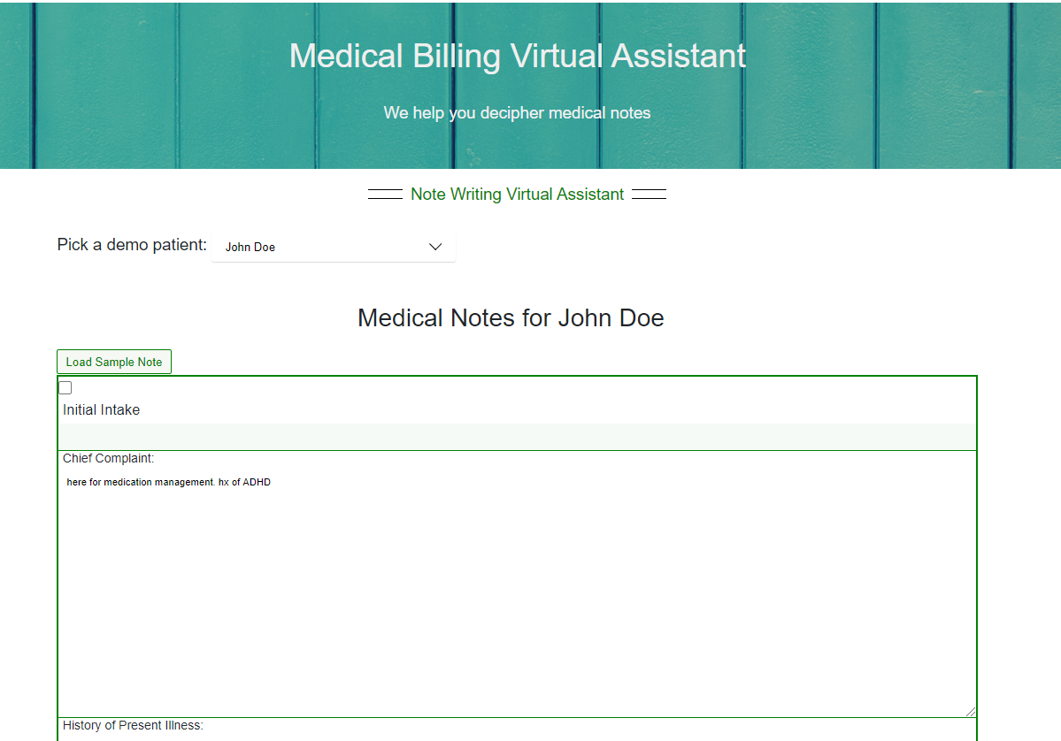




MBVA Application Architecture
Web App
Text Query
Business Logic
Medical Coder
Physician Assistant
Nurse Practitioner
Doctor
Patient
Notes:
Brent:
The project architecture for our user interface is shown here;
The user experience mimics that of an electronic medical record system (EMR). The note can be typed directly into the application, or pasted from another system such as EpicCare.
The site is hosted via AWS Amplify and runs Javascript with React
The query is sent to a flask REST API that will run the data through an ensemble of models trained on the embeddings from Clinical BERT.
The medical note also has business logic applied such that an EM code can be supplied
This information is then shown alongside the note for the user

Slide 8
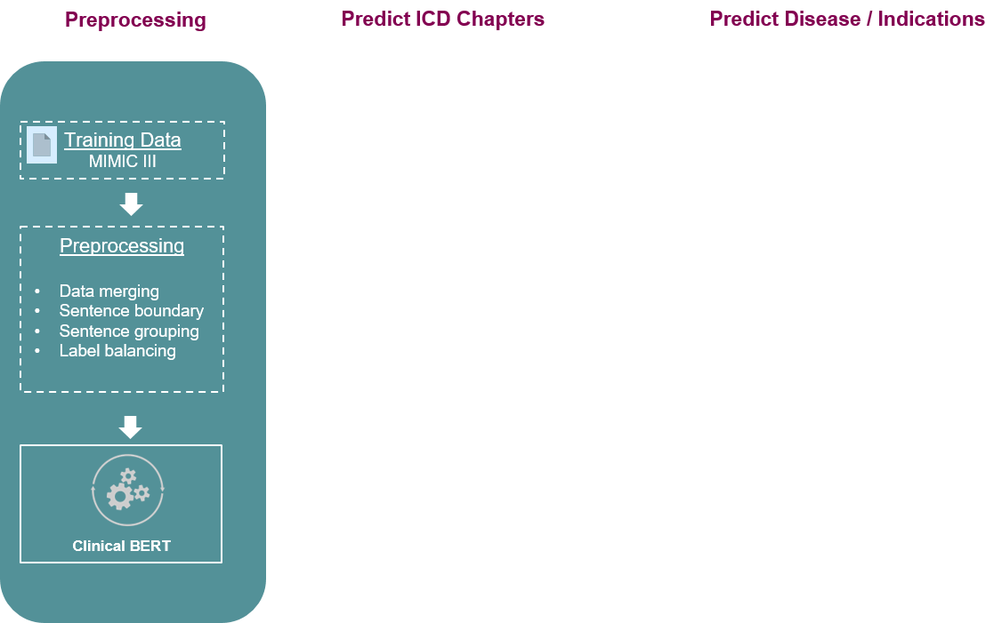
Divide and Conquer with An Ensemble of Multi-Label Classifiers
Notes:
Now we would like to share with you a high level view of our model
There are three main modules in our model
A preprocessing module followed by 2 multilabel classification layers
As part of preprocessing we focus on identifying Sentence boundaries in the notes that we extract from MIMIC III database.
Then we group these sentences into larger chunks and pass them into BERT model to generate embeddings
There is another specific reason and application for building the sentence groups which we will touch upon in a few minutes

Slide 9
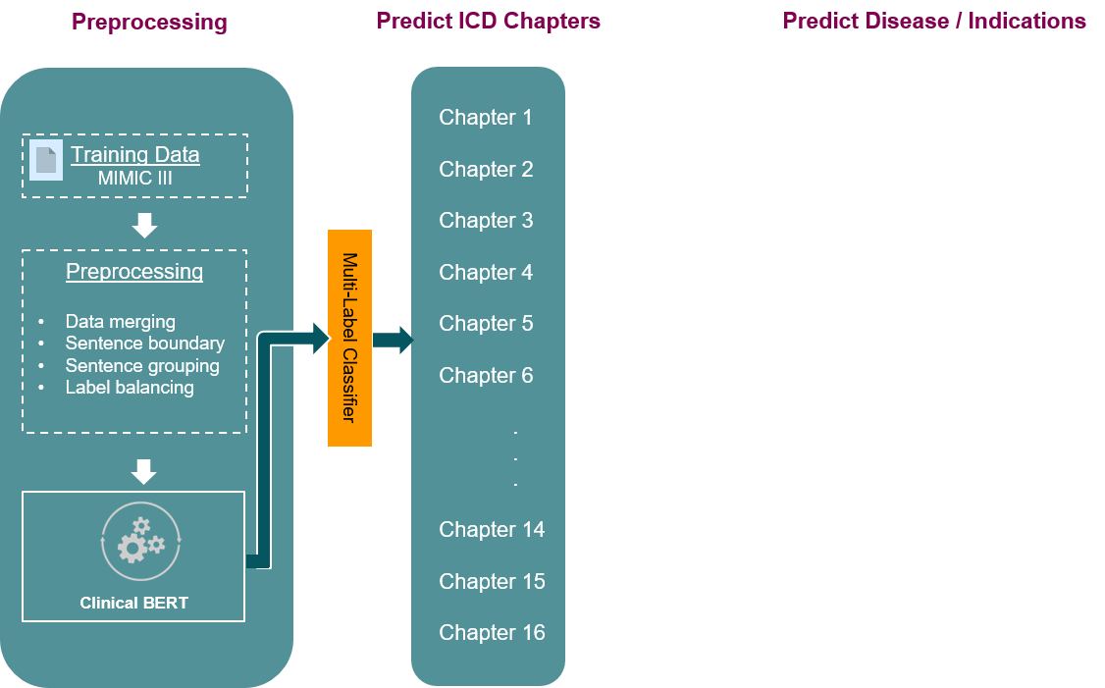
Divide and Conquer with An Ensemble of Multi-Label Classifiers
Notes:
Once we have the word embeddings from BERT we pass it through a CNN multi-label classifier to predict the appropriate chapters for the diagnosis codes.
These chapters can also be thought of as specific therapy areas like Respiratory, heart failure, renal insufficiencies, metabolic etc. But in essence each label on this stage points to an actual chapter in the Diagnosis code reference book which was briefly touched upon by Haifeng during the introductions
Once we have identified the chapters we move onto more granular disease category predictions

Slide 10
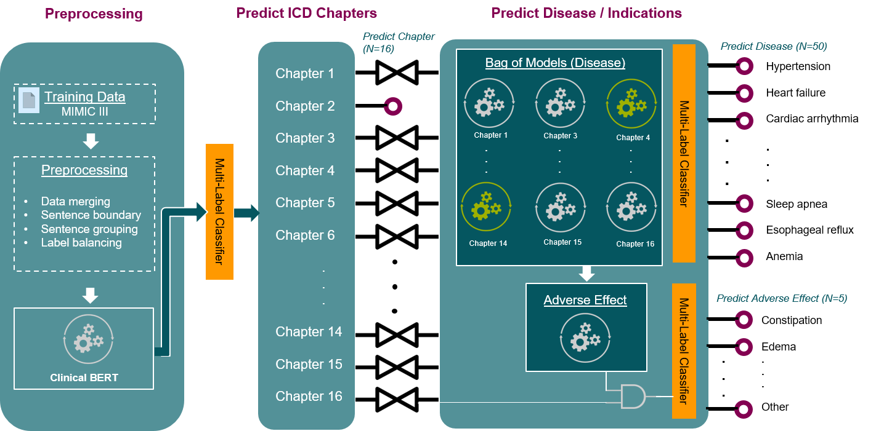
Divide and Conquer with An Ensemble of Multi-Label Classifiers
Notes:
At this stage we have an ensemble of 16 models which leverage the information learned in the previous layer. This improves both speed and precision for training and inference.
So overall we have a total of 66 labels: 16 labels that predict the diagnosis chapters in layer 1 and 50 labels that predict more granular disease categories in layer 2
On next slide we will walk you through the evolution of our model

Slide 11
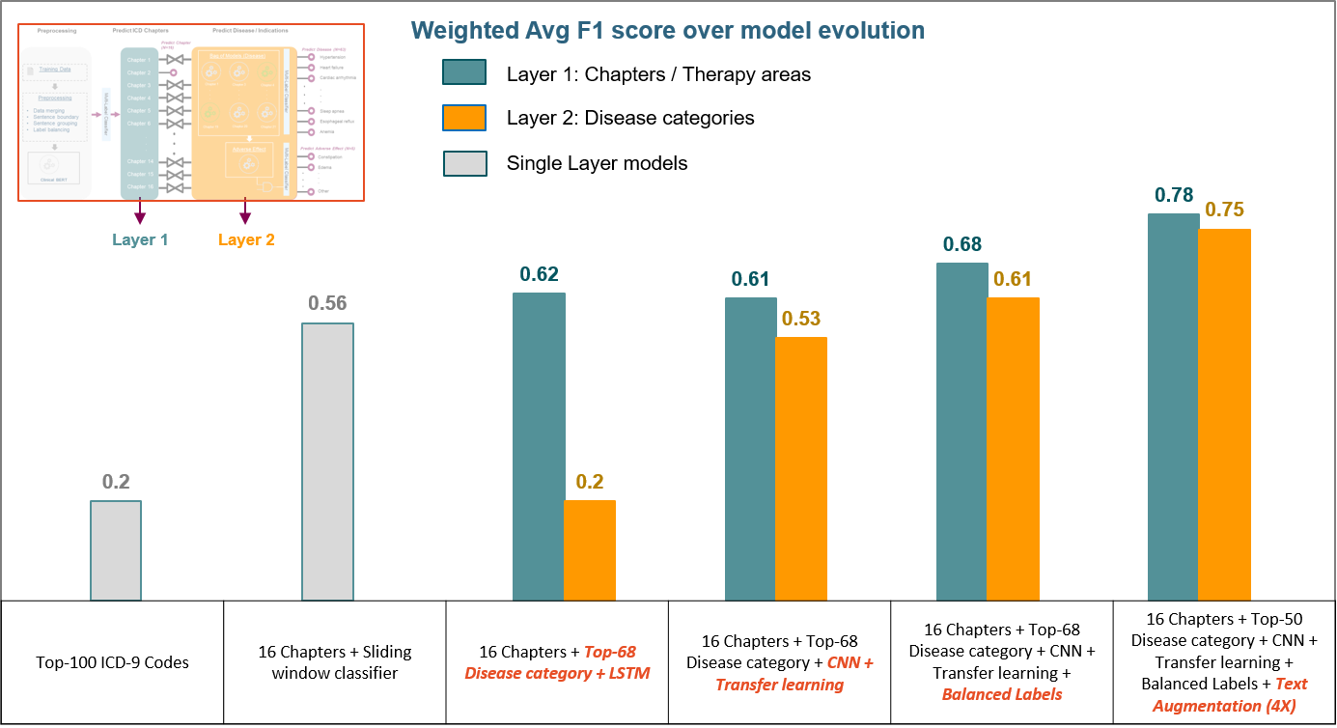
F1 Scores - Because Both Precision and Recall Are Important
Final model Tested on 3 batches with 10k unseen documents each
Notes:
Right off the bat we knew that we had a difficult problem at hand with about 8000 frequently referenced ICD codes
Through substantial effort and experimentation we were able to improve our model performance 4 folds from an F1 score of 0.2 when we started to an F1 score of 0.78 in our final model
The key strategies that lead to this improvement are:
First and foremost - Identifying the high level categorization which we refer to as 16 chapter labels in layer 1 and 50 disease categories in layer 2
Moreover we built in transfer learning from layer 1 to layer 2 in order to improve precision and reduce training and inference time
We also undersampled the data to achieve balanced labels. This lead to an improvement of 15% in F1 score over the original unbalanced dataset
And finally we were able to boost the performance by another 14% in layer 1 and 22% in layer 2 through text augmentation. We essentially multiplied the training data by randomly reordering the sentence grouping which was developed in the pre-processing layer

Slide 12
Comparison to Others
Publications / Previous work | Prediction | F1 Scores
Explainable Prediction of Medical Codes from Clinical Text Association for Computational Linguistics, June 2018 | Secondary prediction: Top 50 ICD codes | 0.63
Tagging Patient Notes With ICD-9 Codes 29th Conference on Neural Information Processing Systems | 19 High level ICD-9 Categories | 0.71
An empirical evaluation of deep learning for ICD-9 code assignment using MIMIC-III clinical notes Computer Methods and Programs in Biomedicine, May 2019 | Top-10 ICD-9 codes | 0.72
Multimodal Machine Learning for Automated ICD Coding Proceedings of Machine Learning Research, Aug 2019 | Top-32 ICD-9 codes | 0.76
Medical Billing Virtual Assistant (MBVA) MIDS Capstone 2020 | 16 therapy areas Most prevalent Disease category across these therapy areas (N=50) | Chapter / Therapy Areas: 0.78 Disease category@50: 0.75
Notes:
On this slide we compare our model with existing work in the task of predicting medical diagnosis from clinical notes.
And we were thrilled to see that we clearly outperform several of the existing models in this domain
I believe we were able to achieve this through teamwork, strong model strategies and a lot of patience…
Up next Gaurav will walk us through a brief demo of our web application to see all of this in action

Slide 13

UI Demo
Medical Billing Virtual Assistant (MBVA)
Preparing to shape the future of medical coding
Sample Note
Neonatal Discharge Summary
Notes:
Gaurav

Slide 14
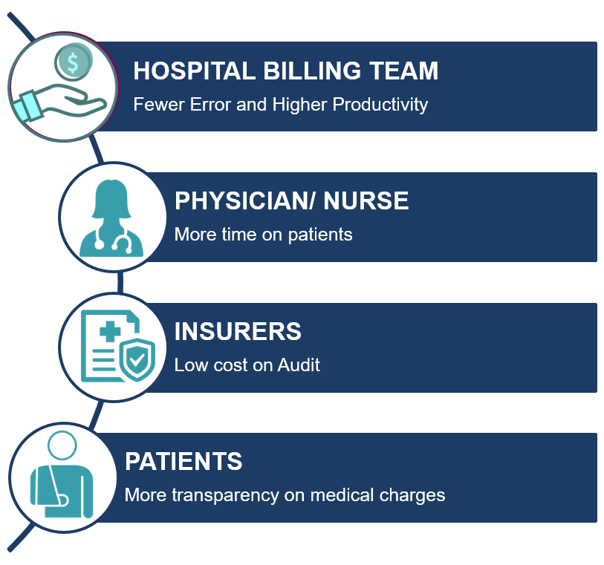


Benefits of MBVA
Notes:
Brent
From our demo, we can see the benefit of MBVA
We can go from notes to billing codes in seconds and reduce the rate of errors .
This allows coders to concentrate on complex tasks
MBVA gains efficiencies across the healthcare industry:
1. The Billing team introduce fewer errors & therefore have higher productivity
2. Medical Staff are able to spend more time with patients
3. Insurers have lower costs because of more consistency & less auditing
4. Patients have additional transparency with their claims

Slide 15

Future Roadmap
Improve model predictions
Expand to medical procedures and other service level codes
Integrate with existing Electronic Medical Record (EMR) systems
Build AI writing assistant for physicians
Notes:
Brent
Our roadmap for the future includes a number of improvements to our product:
We will work to improve the accuracy of our models
We will expand our product to predict medical procedures & other codes
Eventually, our goal is for integration with an existing Electronic medical record system
And, finally to Offer a writing assistant for physician notes

Slide 16




The Team
Anish Philip
Medical SME and Model Builder
Brent Biseda
Product Manager
Gaurav Desai
UI Developer
Haifeng Lin
Project Manager
Notes:
Brent
Pictured here are the members of our team and their significant area of contribution on this project.
We thank you for your time and attention and will now take any questions from the audience.

Slide 17
Medical Billing Virtual Assistant (MBVA)
Preparing to shape the future of medical coding
Q&A
Thank you
Notes:
Brent

Slide 18
Team Responsibility

Slide 19
Team Member Accomplishment - Brent Biseda
01
01
Determine initial project scope
02
Obtain SME inputs
03
Decide product design and features
04
Create Flask Backend

Slide 20
Team Member Accomplishment - Gaurav Desai
01
01
Create UI
02
Decide product design and features
03
Setup AWS environment for the project

Slide 21
Team Member Accomplishment - Anish Philip
01
01
Conduct EDA and feature engineering
02
Build, run, and decide ML models
03
Our SME in healthcare industry
04
Final presentation PPT (Branding and Structure)

Slide 22
Team Member Accomplishment - Haifeng Lin
01
Construct ppt for regular update and graded presentation
01
02
Manage project and coordinate meetings
03
Create contents for the UI

Slide 23
Appendix

Slide 24
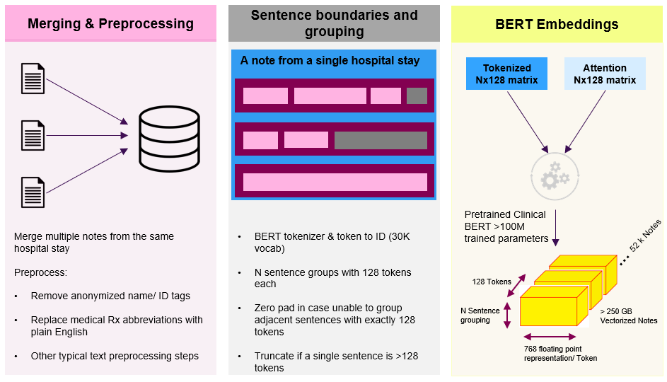
Preprocessing Clinical Text from MIMIC-III
Notes:
Move to appendix

Slide 25
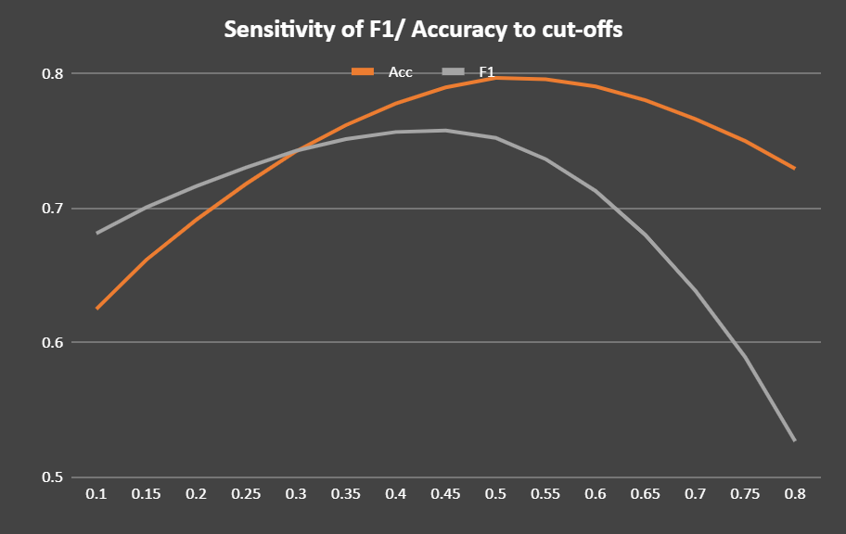
Results and Evaluation
Cut-offs at 0.5 yields the best model performances

Slide 26
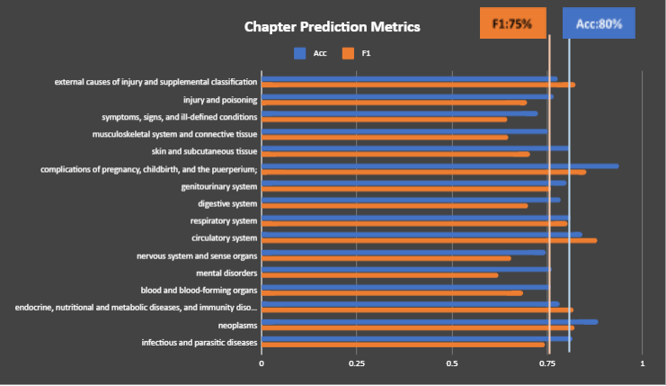
Results and Evaluation
Model performances are relatively consistent across 16 chapters, with average F1 score of 75% and Accuracy of 80%

Slide 27
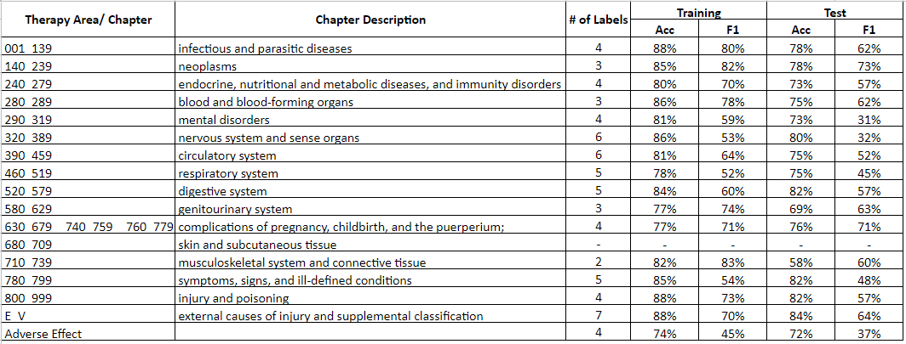
Individual Model Performance

Slide 28
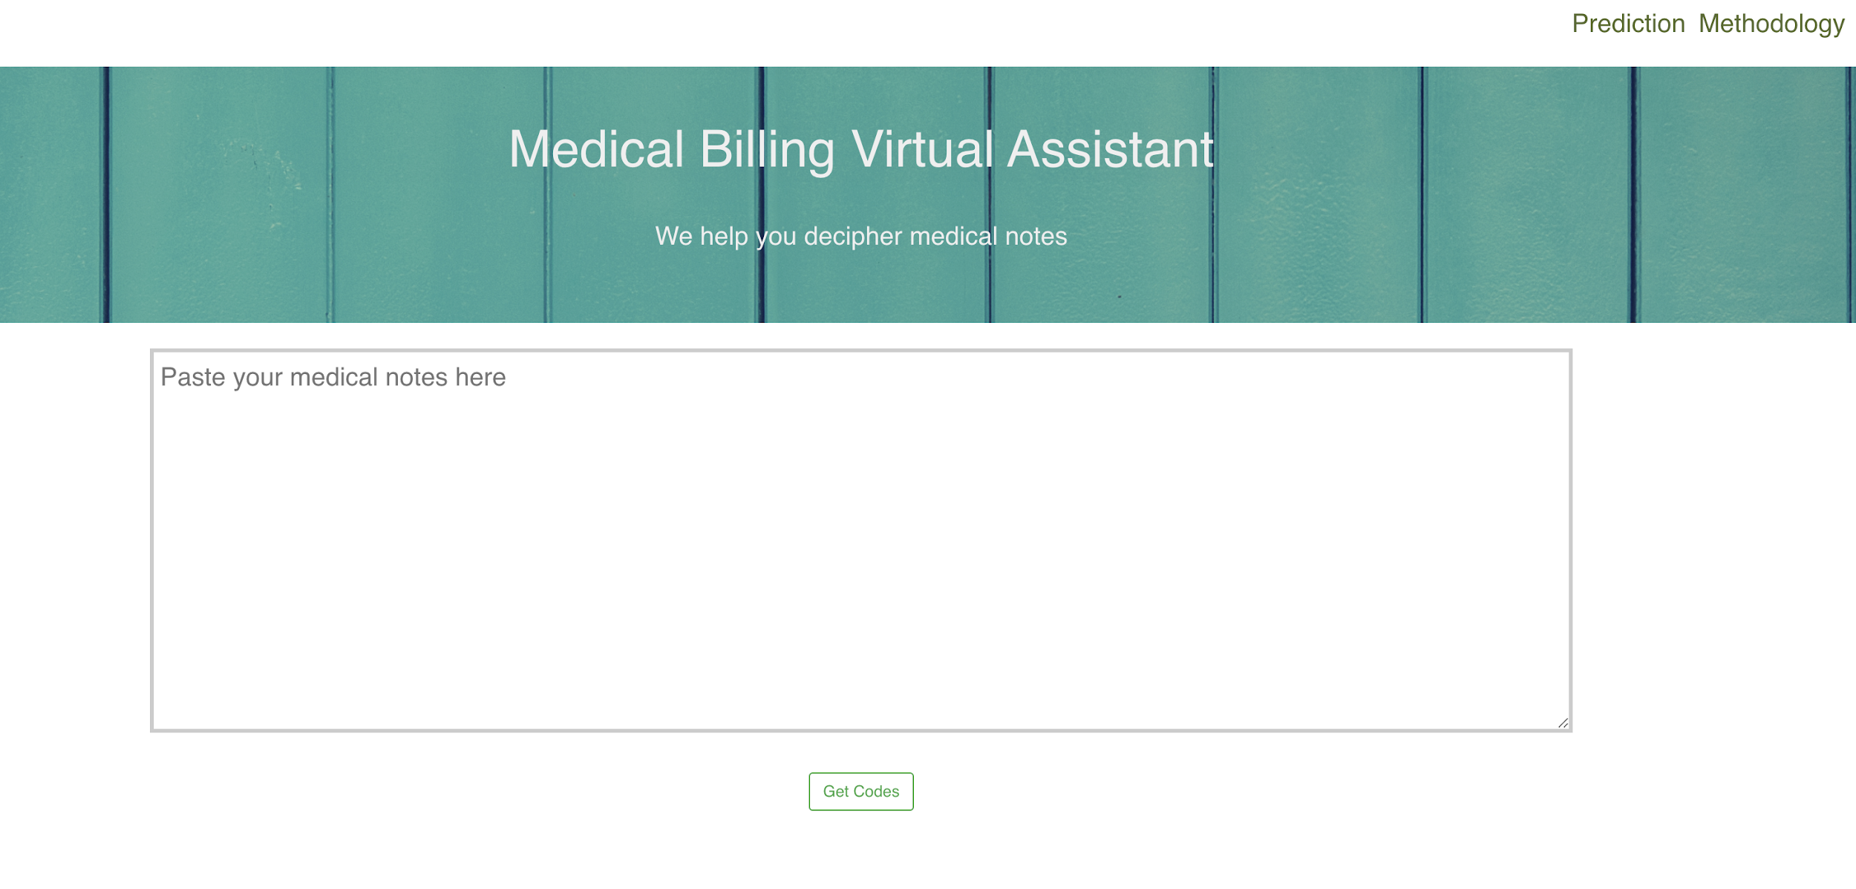

Slide 29
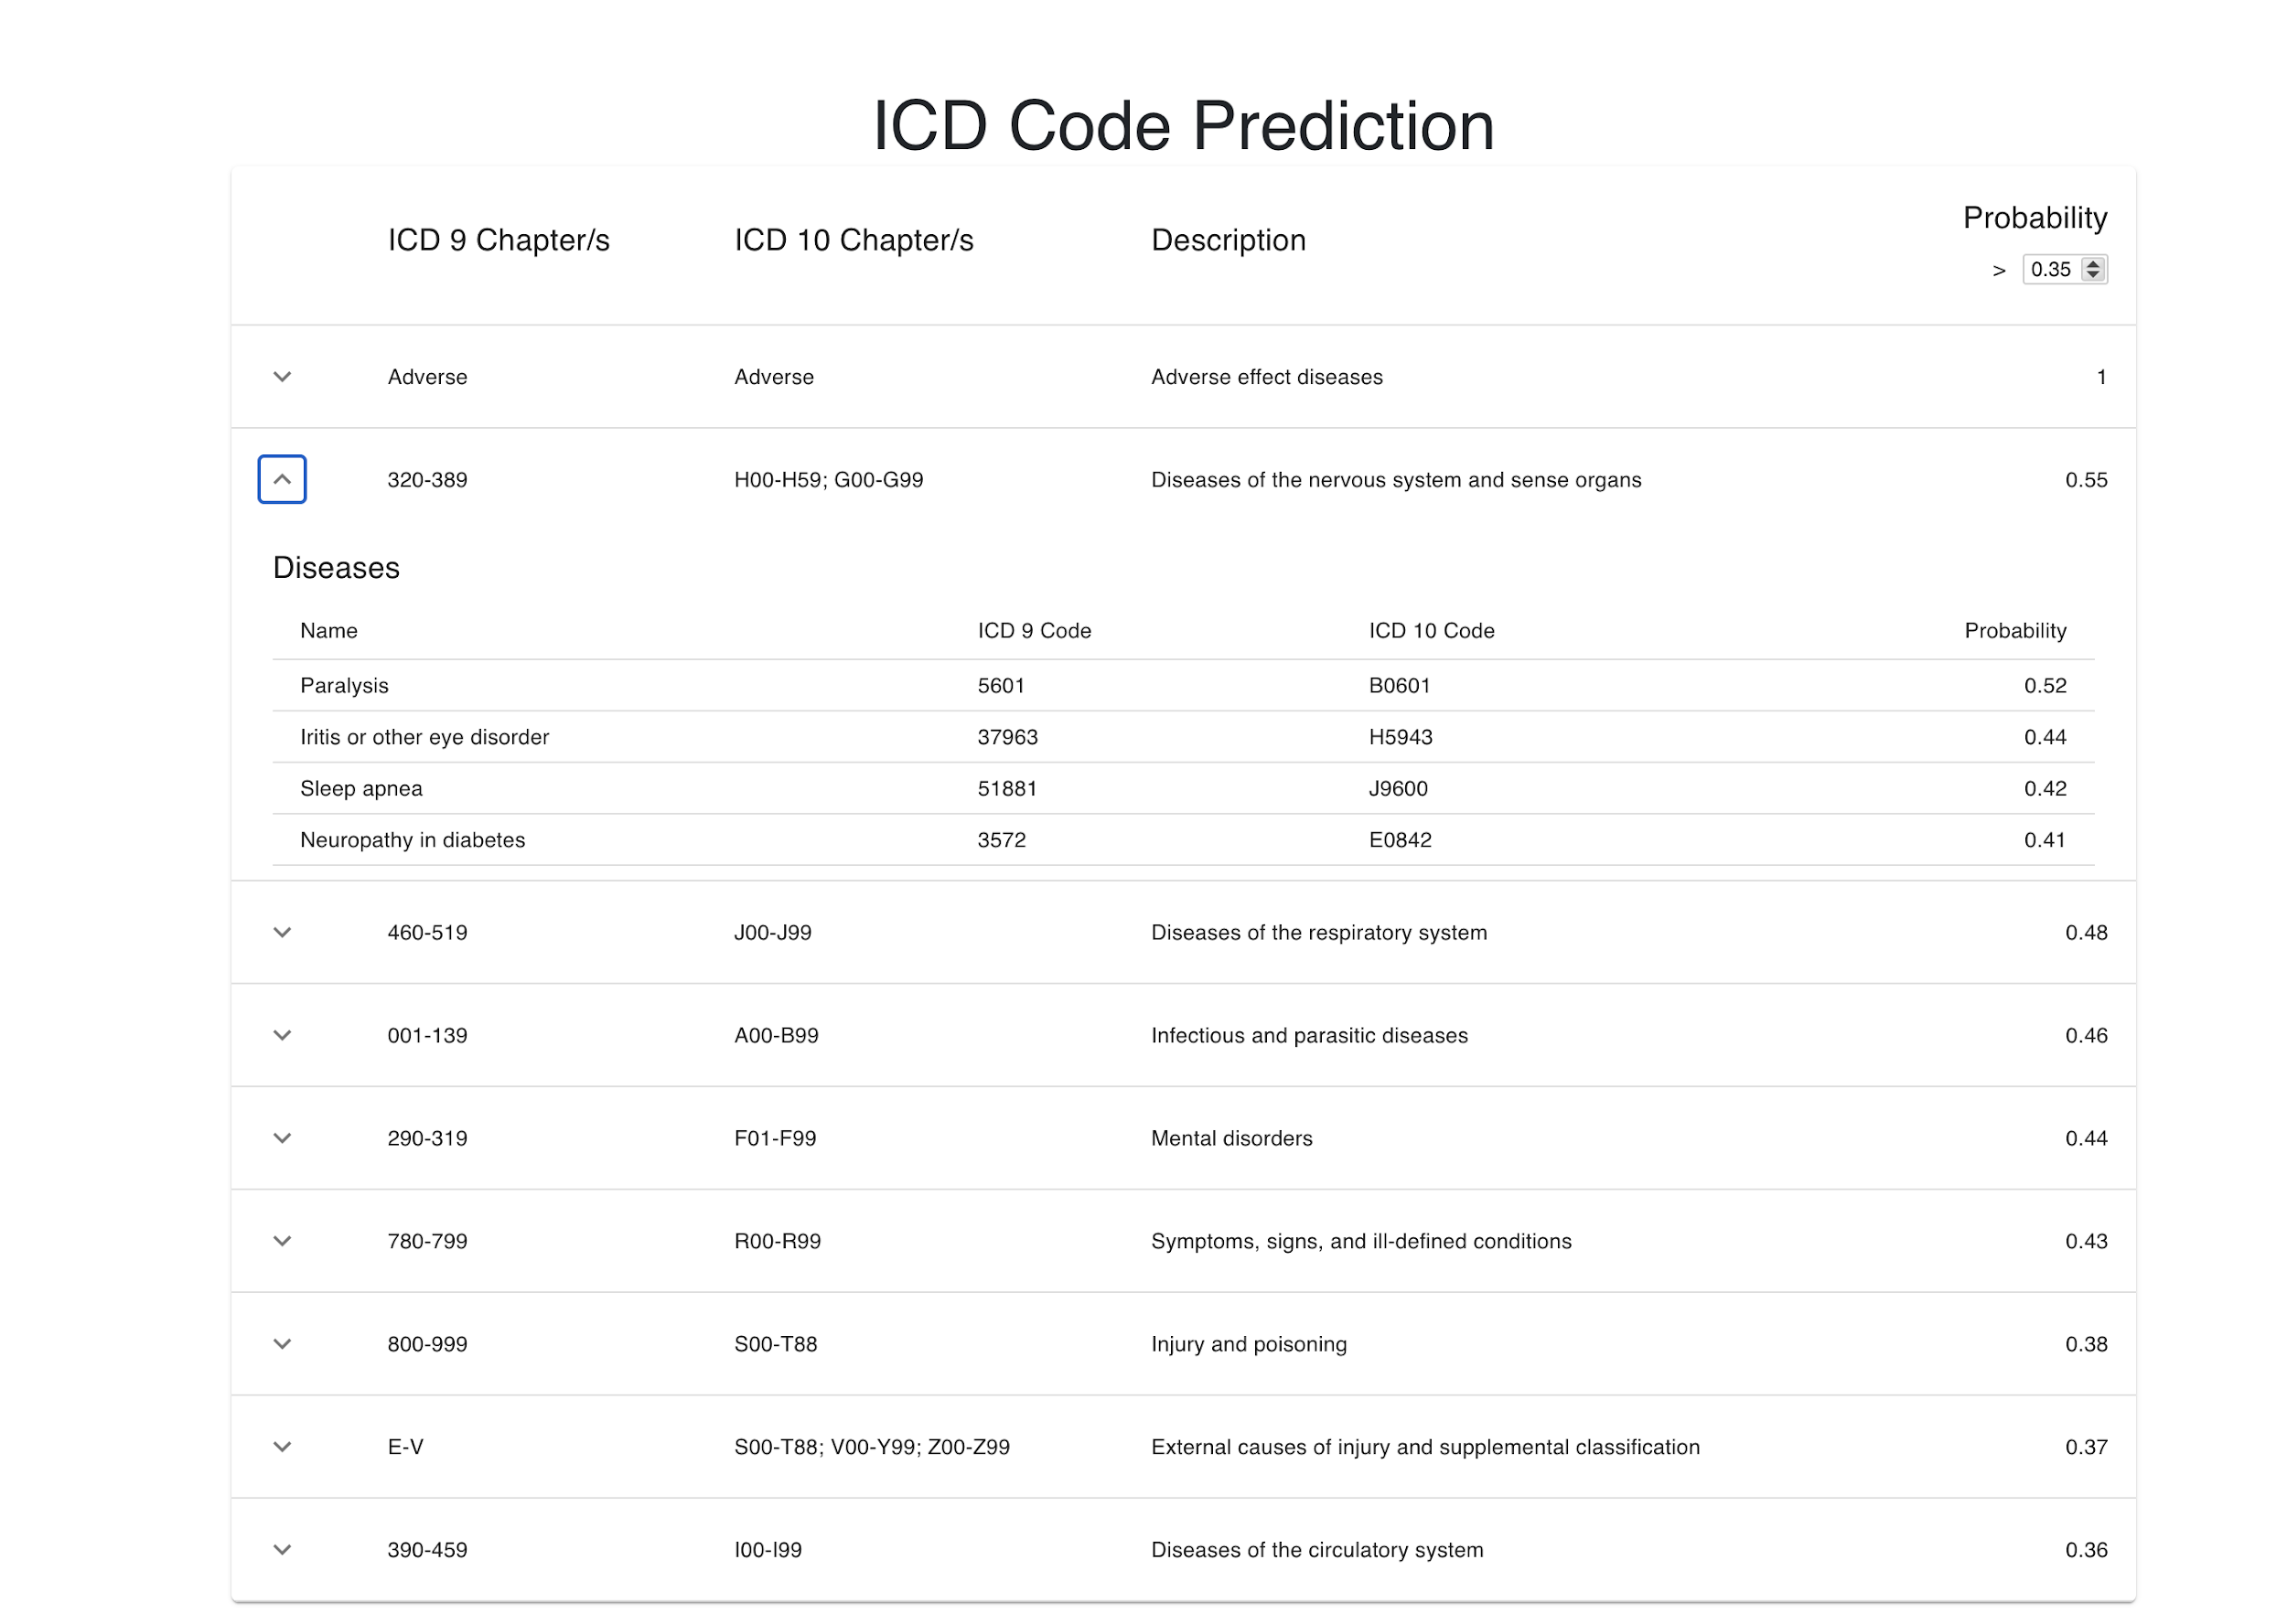

Slide 30
